Slide 1

CONSUMER EQUILIBRIUM ANALYSIS

Slide 2
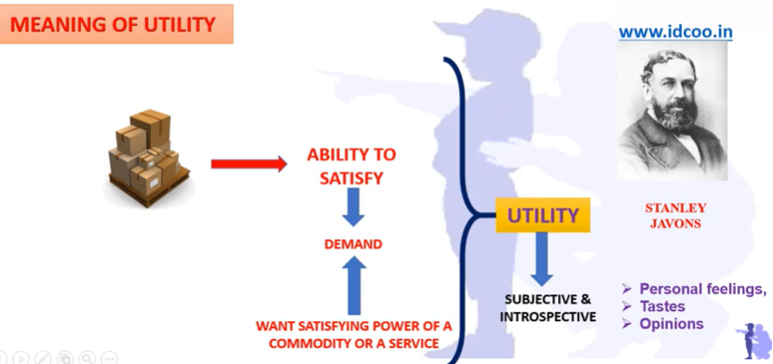
UTILITY

Slide 3
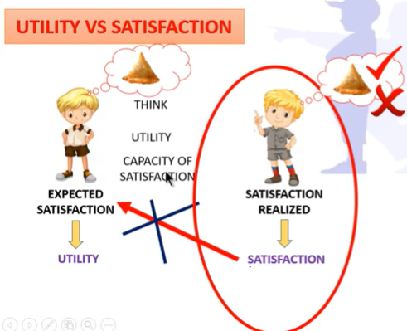

Slide 4
Consumer Behavior
What guides these individual consumer decisions?
Why do consumers purchase some commodities and not others?
How do they decide how much to purchase of each commodity?
What is the aim of a rational consumer in spending income?
Notes:
8

Slide 5
Consumer Behavior
Recall one of the Ten Principles from Chapter 1:
People face tradeoffs.
  Buying more of one good leaves
  less income to buy other goods.
  Working more hours means more income and more consumption, but less leisure time.
  Reducing saving allows more consumption today but reduces future consumption.
This chapter explores how consumers make choices like these.

Slide 6
Consumer Behavior
There are 3 steps involved in studying consumer behavior.
Consumer preferences: describe how and why people prefer one good to another.
Budget constraints: people have limited incomes.
We will combine consumer preferences and budget constraints to determine consumer choices.
    What combination of goods will consumers buy to maximize their satisfaction?
Notes:
8

Slide 7
Consumer Behavior
Ordinal Versus Cardinal Utility
  Ordinal Utility Function: places market baskets from most preferred to least preferred, but does not indicate how much one market basket is preferred to another.
  Cardinal Utility Function: describes the extent to which one market basket is preferred to another.
Ordinal Versus Cardinal Rankings
  The actual unit of measurement for utility is not important. Therefore, an ordinal ranking is sufficient to explain how most individual decisions are made.
Notes:
27

Slide 8
Consumer Behavior
Because the consumer’s wants are unlimited and in any event, exceed his or her ability to satisfy them all, it is important that the consumer spend income so as to maximize satisfaction.
Thus, a model is provided to illustrate and predict how a rational consumer maximizes satisfaction, given his or her preferences (indifference curves) and the constraints that the consumer faces (the budget line)
Notes:
8

Slide 9
II. Two Explanations of the Law of Demand
A. Income and substitution effects explain the inverse relationship between price and quantity demanded.
1. The income effect is the impact of a change in price on consumers’ real incomes and on the quantity of that product demanded.
An increase in price means that less real income is available to buy subsequent amounts of the product.

Slide 10
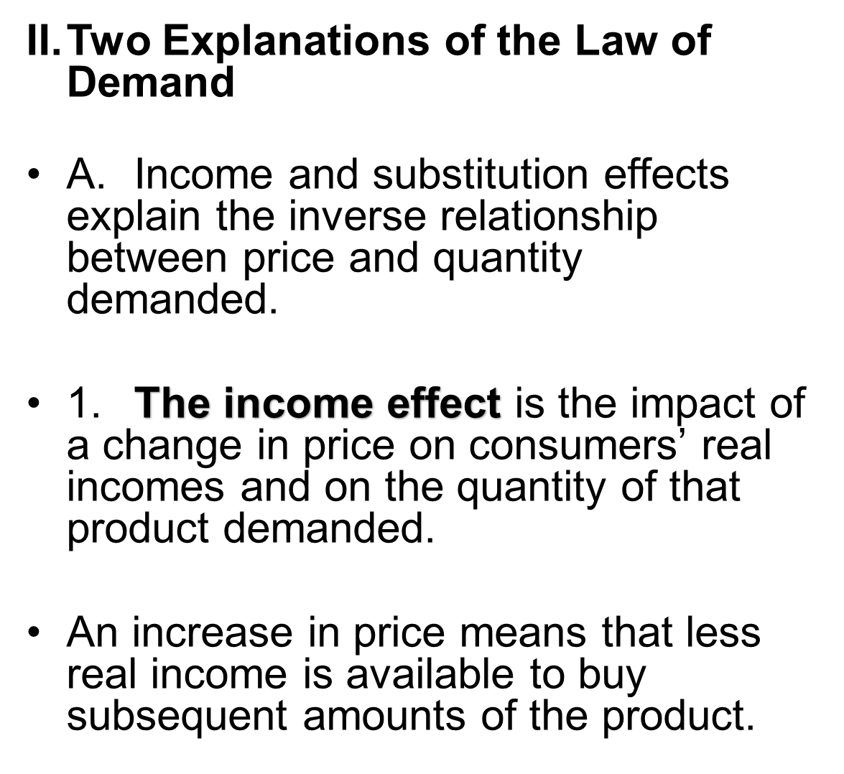
You have less income to buy same amount of the product as before

Slide 11
2. The substitution effect
A higher price for a particular product means that the item has become relatively more expensive compared to its substitutes. (i.e. Tea and Coffee)
Therefore, consumers will buy less of this product and more of the substitutes, whose prices are relatively lower than before.

Slide 12
2. The substitution effect
A higher price for a particular product means that the item has become relatively more expensive compared to its substitutes. (i.e. Tea and Coffee)
Therefore, consumers will buy less of this product and more of the substitutes, whose prices are relatively lower than before.
other products are cheaper now

Slide 13
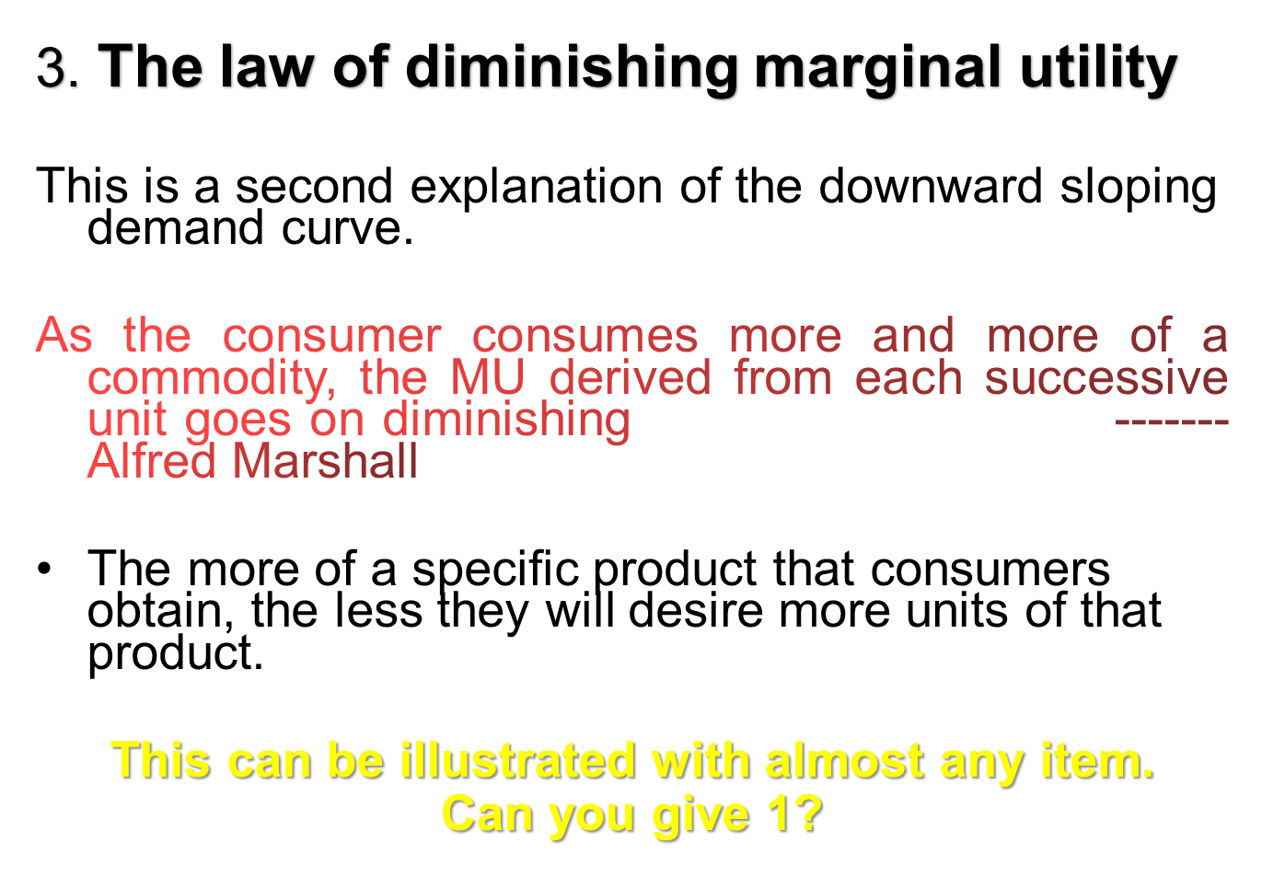

Slide 14
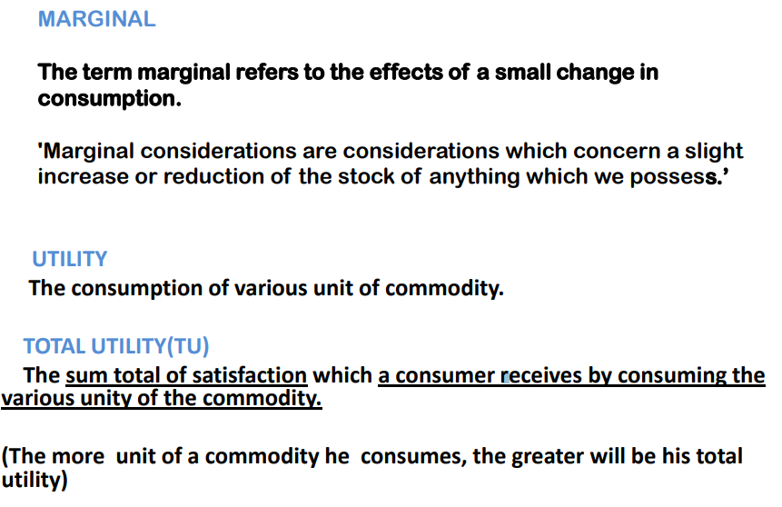
Basic Terminology

Slide 15
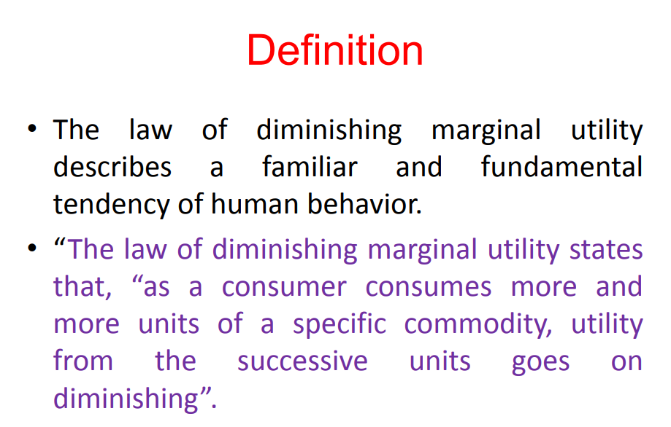

Slide 16
ASSUMPTIONS
1. Rational Behavior (means that the consumer wants to gain maximum satisfaction with limited resources)
2. Consumer’s income is given (limited resources)
3. Spend all income on goods consumption
4. The prices of the commodities are constant

Slide 17
Cont....
5. Cardinal measurement of utility:- It is assumed that utility can be measured and can be given definite quantity like 1,2 or 3.This means that a person can express the satisfaction derived from consumption of commodity in quantitative term.
6. Utilities are independent:-Marginal utility assumes that utility of different commodities are independent to each other.
7. Constant Marginal utility of money:-Another important assumption is that the marginal utility of money remains constant.

Slide 18
BASIC LAWS OF MARGINAL UTILITY
LAW OF DIMINISING MARGINAL UTILITY

Slide 19
LAW OF DIMINISHING MARGINAL UTILITY
This law can be stated as the fall in marginal utility of any good due to successive consumption of that good.
For ex:- Suppose a person starts eating sweet, the first sweet gives him great pleasure. By the time he taking second he yield less satisfaction; the satisfaction of third is less than that of second and so on. The additional satisfaction goes on decreasing with every successive sweet till it drops down to zero; and if the consumer forced to take more the satisfaction may become less than zero.

Slide 20

TOTAL AND MARGINAL UTILITY
sweet
consumed
After meal
Total
Utility,
Utils
Marginal
Utility,
Utils
30
20
10
0
1
0
10
Total Utility (utils)
0 1 2 3 4 5 6 7
Units consumed per meal
10
8
6
4
2
0
-2
Marginal Utility (utils)
1 2 3 4 5 6 7
Units consumed per meal

Slide 21
TOTAL AND MARGINAL UTILITY
sweet
consumed
After meal
Total
Utility,
Utils
Marginal
Utility,
Utils
30
20
10
0
1
0
10
Total Utility (utils)
10
0 1 2 3 4 5 6 7
Units consumed per meal
10
8
6
4
2
0
-2
Marginal Utility (utils)
1 2 3 4 5 6 7
Units consumed per meal

Slide 22
TOTAL AND MARGINAL UTILITY
sweet
consumed
After meal
Total
Utility,
Utils
Marginal
Utility,
Utils
30
20
10
0
1
2
0
10
18
Total Utility (utils)
10
8
0 1 2 3 4 5 6 7
Units consumed per meal
10
8
6
4
2
0
-2
Marginal Utility (utils)
1 2 3 4 5 6 7
Units consumed per meal

Slide 23
TOTAL AND MARGINAL UTILITY
sweet
consumed
After meal
Total
Utility,
Utils
Marginal
Utility,
Utils
30
20
10
0
1
2
3
0
10
18
24
Total Utility (utils)
10
8
6
0 1 2 3 4 5 6 7
Units consumed per meal
10
8
6
4
2
0
-2
Marginal Utility (utils)
1 2 3 4 5 6 7
Units consumed per meal

Slide 24
TOTAL AND MARGINAL UTILITY
sweet
consumed
After meal
Total
Utility,
Utils
Marginal
Utility,
Utils
30
20
10
0
1
2
3
4
0
10
18
24
28
Total Utility (utils)
10
8
6
4
0 1 2 3 4 5 6 7
Units consumed per meal
10
8
6
4
2
0
-2
Marginal Utility (utils)
1 2 3 4 5 6 7
Units consumed per meal

Slide 25
TOTAL AND MARGINAL UTILITY
sweet
consumed
After meal
Total
Utility,
Utils
Marginal
Utility,
Utils
30
20
10
0
1
2
3
4
5
0
10
18
24
28
30
Total Utility (utils)
10
8
6
4
2
0 1 2 3 4 5 6 7
Units consumed per meal
10
8
6
4
2
0
-2
Marginal Utility (utils)
1 2 3 4 5 6 7
Units consumed per meal

Slide 26
TOTAL AND MARGINAL UTILITY
sweet
consumed
After meal
Total
Utility,
Utils
Marginal
Utility,
Utils
30
20
10
0
1
2
3
4
5
6
0
10
18
24
28
30
30
Total Utility (utils)
10
8
6
4
2
0
0 1 2 3 4 5 6 7
Units consumed per meal
10
8
6
4
2
0
-2
Marginal Utility (utils)
1 2 3 4 5 6 7
Units consumed per meal

Slide 27
TOTAL AND MARGINAL UTILITY
TU
sweet
consumed
After meal
Total
Utility,
Utils
Marginal
Utility,
Utils
30
20
10
0
1
2
3
4
5
6
7
0
10
18
24
28
30
30
28
Total Utility (utils)
10
8
6
4
2
0
-2
0 1 2 3 4 5 6 7
Units consumed per meal
10
8
6
4
2
0
-2
Marginal Utility (utils)
MU
1 2 3 4 5 6 7
Units consumed per meal

Slide 28

TOTAL AND MARGINAL UTILITY
TU
sweet
consumed
After meal
Total
Utility,
Utils
Marginal
Utility,
Utils
30
20
10
Observed
Diminishing
Marginal
Utility
0
1
2
3
4
5
6
7
0
10
18
24
28
30
30
28
Total Utility (utils)
10
8
6
4
2
0
-2
0 1 2 3 4 5 6 7
Units consumed per meal
10
8
6
4
2
0
-2
Marginal Utility (utils)
MU
1 2 3 4 5 6 7
Units consumed per meal

Slide 29
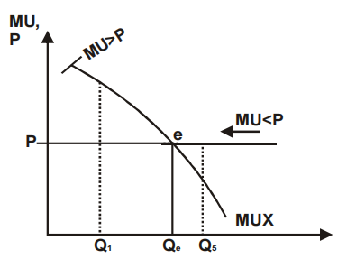

Slide 30
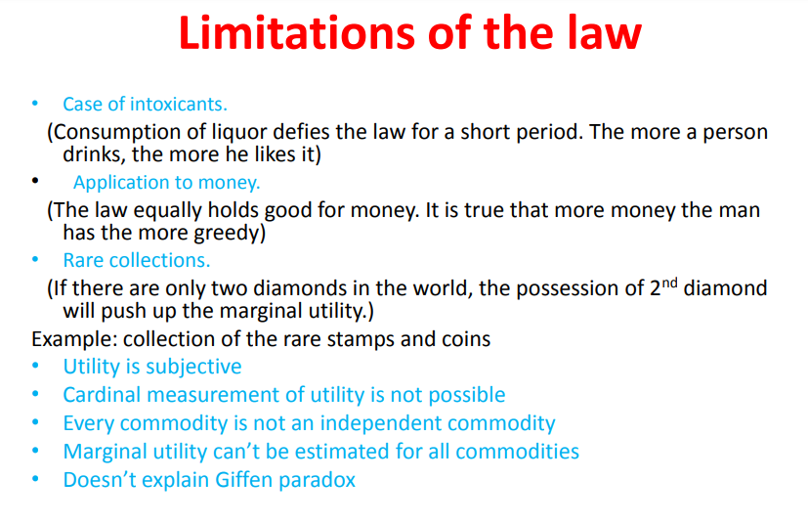

Slide 31
Law of Equi-Marginal Utility
The consumer’s money income should be allocated on products in such a way that the last rupee/ unit spent on each product yields the same amount of marginal utility
illustrated...

Slide 32
UTILITY MAXIMIZING COMBINATION
Product A:
Price = Rs.1
Product B:
Price = Rs.2
Rs. 10
income
Marginal
utility per
rupee
(MU/price)
Marginal
utility per
rupee
(MU/price)
Marginal
utility,
utils
Marginal
utility,
utils
Unit of
product
First 10 10 24 12
How should the Rs.10
income be allocated?

Slide 33
UTILITY MAXIMIZING COMBINATION
Product A:
Price = Rs.1
Product B:
Price = Rs.2
Rs. 10
income
Marginal
utility per
rupee
(MU/price)
Marginal
utility per
rupee
(MU/price)
Marginal
utility,
utils
Marginal
utility,
utils
Unit of
product
First 10 10 24 12
Examine the two
marginal utilities

Slide 34
UTILITY MAXIMIZING COMBINATION
Product A:
Price = Rs.1
Product B:
Price = Rs.2
Rs. 10
income
Marginal
utility per
rupee
(MU/price)
Marginal
utility per
rupee
(MU/price)
Marginal
utility,
utils
Marginal
utility,
utils
Unit of
product
First 10 10 24 12
Examine the two
marginal utilities
…per rupee

Slide 35

UTILITY MAXIMIZING COMBINATION
Product A:
Price = Rs.1
Product B:
Price = Rs. 2
Rs. 10
income
Marginal
utility per
rupee
(MU/price)
Marginal
utility per
rupee
(MU/price)
Marginal
utility,
utils
Marginal
utility,
utils
Unit of
product
First 10 10 24 12
Decision: Buy 1
Product B for Rs.2

Slide 36

UTILITY MAXIMIZING COMBINATION
Product A:
Price = Rs.1
Product B:
Price = Rs.2
Rs. 10
income
Marginal
utility per
rupee
(MU/price)
Marginal
utility per
rupee
(MU/price)
Marginal
utility,
utils
Marginal
utility,
utils
Unit of
product
First 10 10 24 12
Second 8 8 20 10
Third 7 7 18 9
Fourth 6 6 16 8
Fifth 5 5 12 6
Sixth 4 4 6 3
Seventh 3 3 4 2
What next?

Slide 37
UTILITY MAXIMIZING COMBINATION
Product A:
Price = Rs. 1
Product B:
Price = Rs. 2
Rs. 10
income
Marginal
utility per
rupee
(MU/price)
Marginal
utility per
rupee
(MU/price)
Marginal
utility,
utils
Marginal
utility,
utils
Unit of
product
First 10 10 24 12
Second 8 8 20 10
Third 7 7 18 9
Fourth 6 6 16 8
Fifth 5 5 12 6
Sixth 4 4 6 3
Seventh 3 3 4 2

Slide 38
UTILITY MAXIMIZING COMBINATION
Product A:
Price = Rs. 1
Product B:
Price = Rs. 2
Rs. 10
income
Marginal
utility per
rupee
(MU/price)
Marginal
utility per
rupee
(MU/price)
Marginal
utility,
utils
Marginal
utility,
utils
Unit of
product
First 10 10 24 12
Second 8 8 20 10
Third 7 7 18 9
Fourth 6 6 16 8
Fifth 5 5 12 6
Sixth 4 4 6 3
Seventh 3 3 4 2
and then...
(Rs.5 left)

Slide 39
UTILITY MAXIMIZING COMBINATION
Product A:
Price = Rs. 1
Product B:
Price = Rs. 2
Rs. 10
income
Marginal
utility per
rupee
(MU/price)
Marginal
utility per
rupee
(MU/price)
Marginal
utility,
utils
Marginal
utility,
utils
Unit of
product
First 10 10 24 12
Second 8 8 20 10
Third 7 7 18 9
Fourth 6 6 16 8
Fifth 5 5 12 6
Sixth 4 4 6 3
Seventh 3 3 4 2
third unit of
product B

Slide 40
UTILITY MAXIMIZING COMBINATION
Product A:
Price = Rs. 1
Product B:
Price = Rs. 2
Rs. 10
income
Marginal
utility per
rupee
(MU/price)
Marginal
utility per
rupee
(MU/price)
Marginal
utility,
utils
Marginal
utility,
utils
Unit of
product
First 10 10 24 12
Second 8 8 20 10
Third 7 7 18 9
Fourth 6 6 16 8
Fifth 5 5 12 6
Sixth 4 4 6 3
Seventh 3 3 4 2
Rs. 3 left...

Slide 41
UTILITY MAXIMIZING COMBINATION
Product A:
Price = Rs. 1
Product B:
Price = Rs. 2
Rs. 10
income
Marginal
utility per
dollar
(MU/price)
Marginal
utility per
dollar
(MU/price)
Marginal
utility,
utils
Marginal
utility,
utils
Unit of
product
First 10 10 24 12
Second 8 8 20 10
Third 7 7 18 9
Fourth 6 6 16 8
Fifth 5 5 12 6
Sixth 4 4 6 3
Seventh 3 3 4 2
Rs. 3 left...
Buy both!

Slide 42
UTILITY MAXIMIZING COMBINATION
Product A:
Price = Rs. 1
Product B:
Price = Rs. 2
Rs. 10
income
Marginal
utility per
rupee
(MU/price)
Marginal
utility per
rupee
(MU/price)
Marginal
utility,
utils
Marginal
utility,
utils
Unit of
product
First 10 10 24 12
Second 8 8 20 10
Third 7 7 18 9
Fourth 6 6 16 8
Fifth 5 5 12 6
Sixth 4 4 6 3
Seventh 3 3 4 2
Income is gone...
the last rupee spent on
each good gave the same
utility (8) per rupee/ price

Slide 43
UTILITY MAXIMIZING COMBINATION
Algebraic Restatement of the
Utility Maximization Rule
MU of product A
MU of product B
=
Price of A
Price of B
8 Utils
16 Utils
=
Rs.1
Rs.2

Slide 44
Utility Maximization Rule
Of all different affordable combinations of goods and services, which combination will yield the maximum satisfaction?

Slide 45
Utility Maximization Rule
Of all different affordable combinations of goods and services, which combination will yield the maximum satisfaction?
Affordable: Px(X) + Py(Y) = I

Slide 46
Utility Maximization Rule
Of all different affordable combinations of goods and services, which combination will yield the maximum satisfaction?
Mux/Px = Muy/Py

Slide 47
Utility Maximization Rule
Of all different affordable combinations of goods and services, which combination will yield the maximum satisfaction?
Affordable: Px(X) + Py(Y) = I
Px/Mux = Py/MUy
The consumer will allocate (I) so that the last $ spent on a product = the same amount of MU

Slide 48
Utility Maximization Rule
Of all different affordable combinations of goods and services, which combination will yield the maximum satisfaction?
Affordable: Px(X) + Py(Y) = I
Utility maximizing rule
Px/Mux = Py/MUy
The consumer will allocate (I) so that the last $ spent on a product = the same amount of MU

Slide 49
Ordinal utility analysis
The concept of Cardinal Utility was used by Marshal to define Consumer's Equlibrium.
Where as Ordinal Utility means giving the rank to the utility dervied by the consimption of goods and services.
This Concept was given by J.R. Hicks. This is more realstic than cardinal utility. This is totally based on Introspection.

Slide 50
Ordinal Utility Analysis
Indifference analysis/ Ordinal utility analysis is an alternative way of explaining consumer choice that does not require an explicit discussion of utility.
Indifferent: the consumer has no preference among the choices.
Indifference curve: a curve showing all the combinations of two goods (or classes of goods) that the consumer is indifferent among.

Slide 51
Assumptions
Rational Consumer
Non-Satiety (More is Preferred to Less)
Consistency: If a consumer prefer A to B in one period then he will not prefer B to A during that period
Transitivity: If a consumer prefer A to B and B to C, then he must prefer A to C.
Diminishing MRS

Slide 52
Consumer Preferences
Market Basket Units of Food Units of Clothing
A 20 30
B 10 50
D 40 20
E 30 40
G 10 20
H 10 40
Notes:
12

Slide 53
Consumer Preferences
Clothing
(units per week)
Combination B,A, & D
yield the same satisfaction
E is preferred to U₁
U₁ is preferred to H & G
50
B
H
40
E
A
30
D
20
U₁
G
10
Food
(units per week)
10
20
30
40
Notes:
17

Slide 54
Consumer Preferences
  Any market basket lying above and to the right of an indifference curve is preferred to any market basket that lies on the indifference curve.
  Indifference curves cannot cross as this would violate the assumption that more is preferred to less
Notes:
19

Slide 55
Indifference Map
An indifference map is a complete set of indifference curves.
It indicates the consumer’s preferences among all combinations of goods and services.
The farther from the origin the indifference curve is, the more the combinations of goods along that curve are preferred.
Copyright © Houghton Mifflin Company. All rights reserved.

Slide 56
Consumer Preferences
Clothing
(units per week)
Market basket A
is preferred to B.
Market basket B is
preferred to D.
D
B
A
U₃
U₂
U₁
Food
(units per week)
Notes:
24

Slide 57
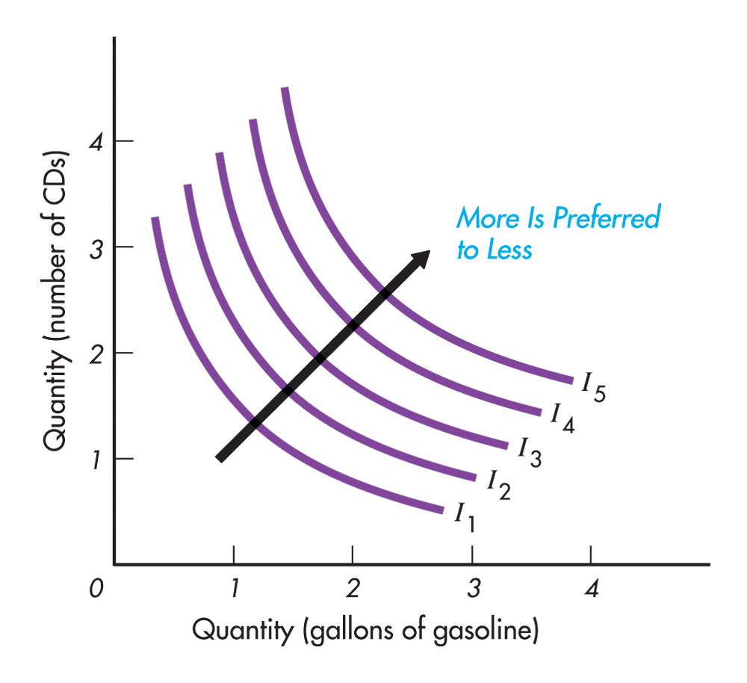

Slide 58
Combination | Oranges | Apples | MRS
A | 1 | 10 | 10:1
B | 2 | 6 | 4:1
C | 3 | 3 | 3:1
D | 4 | 1 | 2:1

Slide 59
Consumer Preferences
Clothing
(units
per week)
16
A
Observation: The amount
of clothing given up for
a unit of food decreases
from 6 to 1
14
12
-6
10
B
1
Question: Does this
relation hold for giving
up food to get clothing?
8
-4
D
6
1
-2
E
4
G
1
-1
2
1
Food
(units per week)
1
2
3
4
5
Notes:
32

Slide 60
Consumer Preferences
Marginal Rate of Substitution
The marginal rate of substitution (MRS) quantifies the amount of one good a consumer will give up to obtain more of another good.
  It is measured by the slope of the indifference curve.
  Along an indifference curve there is a diminishing marginal rate of substitution.
Notes:
29

Slide 61

Consumer Preferences
Clothing
(units
per week)
16
A
14
MRS = 6
12
-6
10
B
1
8
-4
D
MRS = 2
6
1
-2
E
4
G
1
-1
2
1
Food
(units per week)
1
2
3
4
5
Notes:
32
Indifference curves are convex because as more of one good is consumed, a consumer would prefer to give up fewer units of a second good to get additional units of the first one. Consumers prefer a balanced market basket.

Slide 62
Budget Constraints
Preferences do not explain all of consumer behavior.
Budget constraints also limit an individual’s ability to consume in light of the prices they must pay for various goods and services.
The Budget Line: indicates all combinations of two commodities for which total money spent equals total income.
Notes:
46
42

Slide 63

Budget Constraints
The Budget Line
  Let F equal the amount of food purchased, and C is the amount of clothing.
  If the price of food = P_{f} and price of clothing = P_{c}, then P_{f} F is the amount of money spent on food, and P_{c} C is the amount of money spent on clothing.
Notes:
48
42

Slide 64
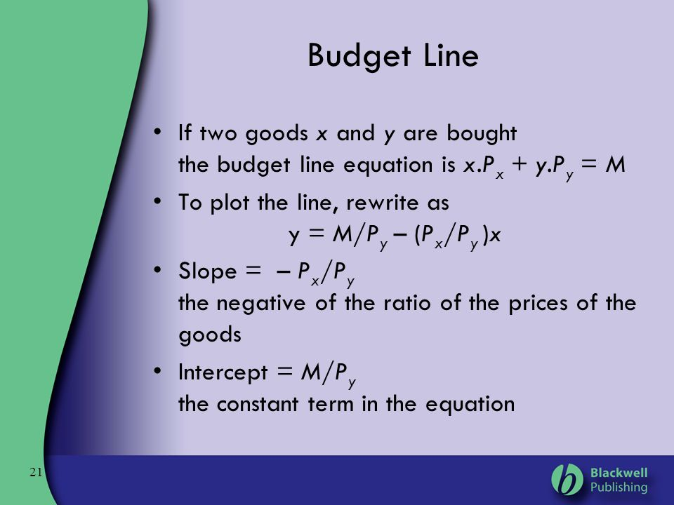

Slide 65
Budget Constraints
Market Basket Food (F) Clothing (C) Total Spending
P_{f} = ($1) P_{c} = ($2) P_{f}F + P_{c}C = I
A 0 40 $80
B 20 30 $80
D 40 20 $80
E 60 10 $80
G 80 0 $80
Notes:
50
12

Slide 66

Budget Constraints
Clothing
(units
per week)
Pc = $2 P_{f} = $1 I = $80
(I/P_{C}) = 40
A
Budget Line F + 2C = $80
B
30
10
D
20
20
E
10
G
Food
(units per week)
0
20
40
60
80 = (I/P_{F})
Notes:
54
42

Slide 67
Budget Constraints
The Budget Line
  As consumption moves along a budget line from the intercept, the consumer spends less on one item and more on the other.
  The slope of the line measures the relative cost of food and clothing = the negative of the ratio of the prices of the two goods.
  The slope indicates the rate at which the two goods can be substituted without changing the amount of money spent.
Notes:
55
42

Slide 68
Budget Constraints: Changes in Income and Prices
Clothing
(units
per week)
An increase in
income shifts
the budget line
outward (holding
prices constant)
80
60
A decrease in
income shifts
the budget line
inward
40
20
L₃
(I =
$40)
L₁
L₂
(I = $80)
(I = $160)
Food
(units per week)
0
40
80
120
160
Notes:
61
42

Slide 69
Budget Constraints: Changes in Income and Prices
Clothing
(units
per week)
An increase in P_{F}
to $2.00 changes
the slope of the
budget line and
rotates it inward
pivoting from the
other good’s intercept.
A decrease in the
price of food to
$.50 changes
the slope of the
budget line and
rotates it outward.
40
L₃
L₁
L₂
(P_{F} = 1)
(P_{F} = 1/2)
(P_{F} = 2)
Food
(units per week)
40
80
120
160
Notes:
65
42

Slide 70
Budget Constraints
The Effects of Changes in Income and Prices
  Price Changes: If the two goods increase in price, but the ratio of the two prices is unchanged, the slope will not change. However, the budget line will shift inward to a point parallel to the original budget line.
  Price Changes: If the two goods decrease in price, but the ratio of the two prices is unchanged, the slope will not change. However, the budget line will shift outward to a point parallel to the original budget line.
Notes:
66
42

Slide 71
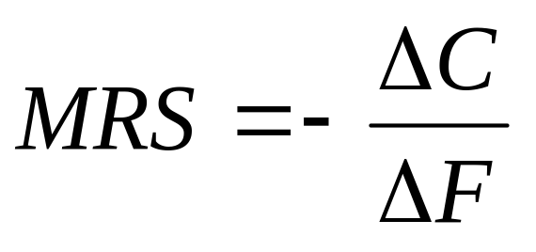
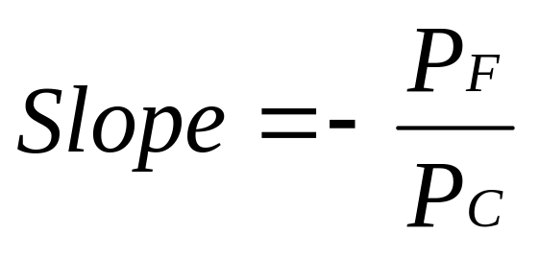
Consumer Choice
Recall, the slope of an indifference curve is:
Further, the slope of the budget line is:
Notes:
70

Slide 72
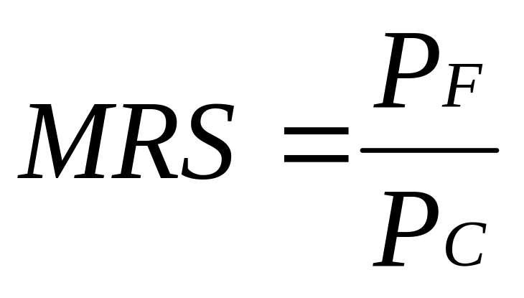
Consumer Choice
Therefore, it can be said that satisfaction is maximized where:
Notes:
71
It can be said that satisfaction is maximized when marginal rate of substitution (of F and C) is equal to the ratio of the prices (of F and C).

Slide 73
Consumer Choice
Clothing
(units per
week)
Pc = $2 P_{f} = $1 I = $80
Point B does not
maximize satisfaction
because the
MRS (-(-10/10) = 1
is greater than the
price ratio (1/2).
40
B
30
-10C
Budget Line
20
U₁
+10F
0
20
40
80
Food (units per week)
Notes:
76

Slide 74
Consumer Choice
Clothing
(units per
week)
Pc = $2 P_{f} = $1 I = $80
40
D
Market basket D
cannot be attained
given the current
budget constraint.
30
20
U₃
Budget Line
0
20
40
80
Food (units per week)
Notes:
77

Slide 75
Consumer Choice
Clothing
(units per
week)
Pc = $2 P_{f} = $1 I = $80
At market basket A
the budget line and the
indifference curve are
tangent and no higher
level of satisfaction
can be attained.
40
30
A
20
At A:
MRS =P_{f}/P_{c} = .5
U₂
Budget Line
0
20
40
80
Food (units per week)
Notes:
78

Slide 76
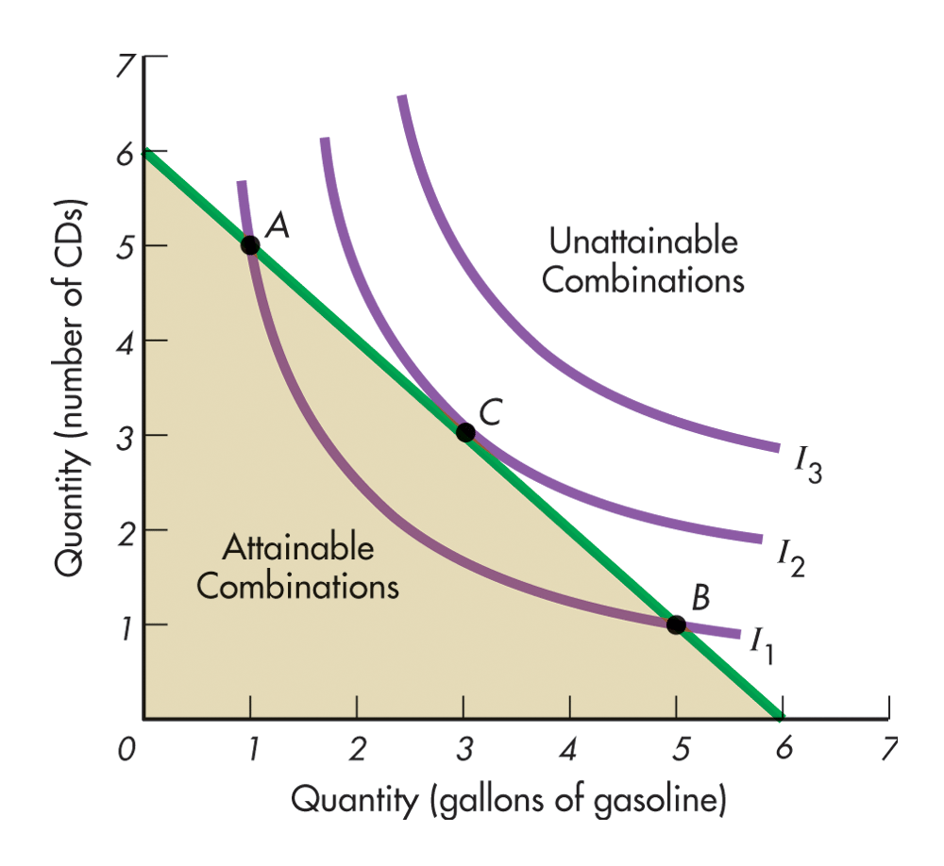
Consumer Equilibrium

Slide 77


Marginal Utility and
Consumer Choice
When consumers maximize satisfaction the:
Since the MRS is also equal to the ratio of the marginal utilities of consuming F and C, it follows that:
Notes:
115

Slide 78

Marginal Utility and
Consumer Choice
Which gives the equation for utility maximization:
Notes:
116
Total utility is maximized when the budget is allocated so that the marginal utility per dollar of expenditure is the same for each good.
This is referred to as the equal marginal principle.

Slide 79
Consumer Equilibrium
The indifference map in combination with the budget line allows us to determine the one combination of goods and services that the consumer most wants and is able to purchase. This is the consumer equilibrium.
The demand curve for a good can be derived from indifference curves and budget lines by changing the price of one of the goods (leaving everything else the same) and finding the equilibrium points.

Slide 80
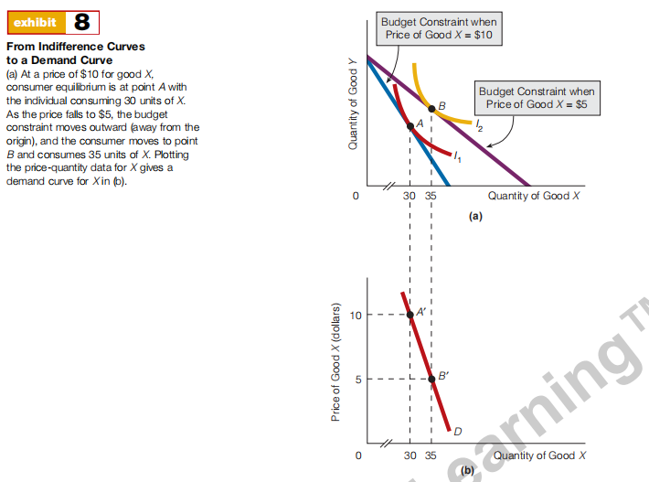

Slide 81
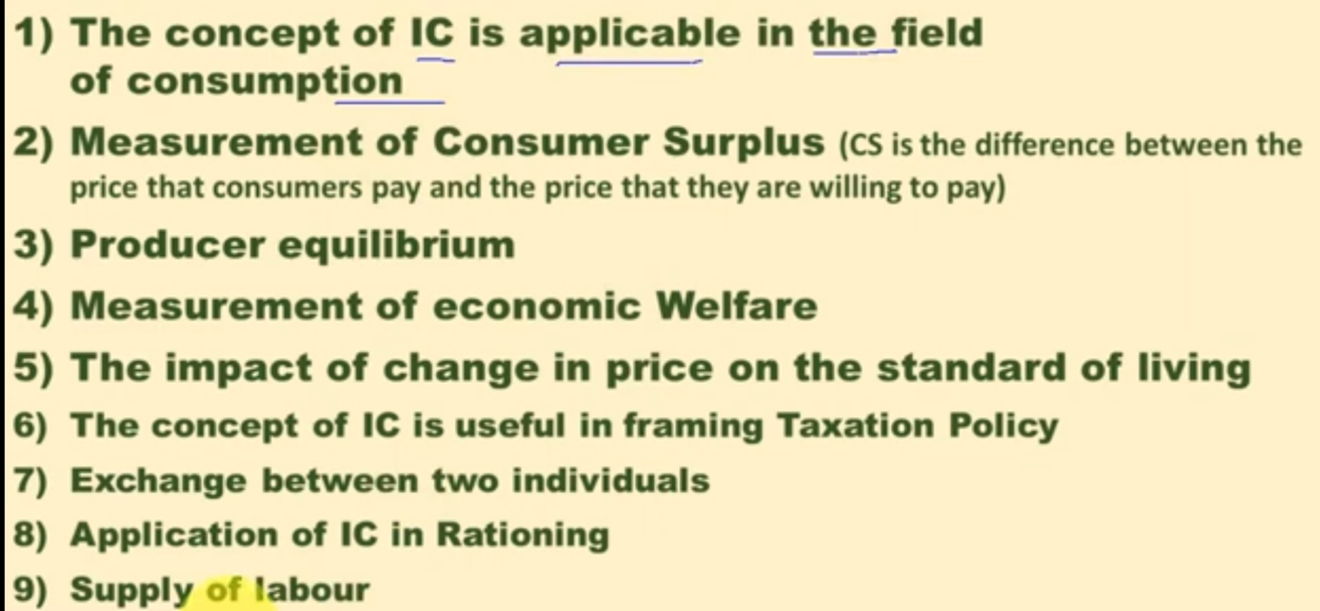
Application of ICs

Slide 82
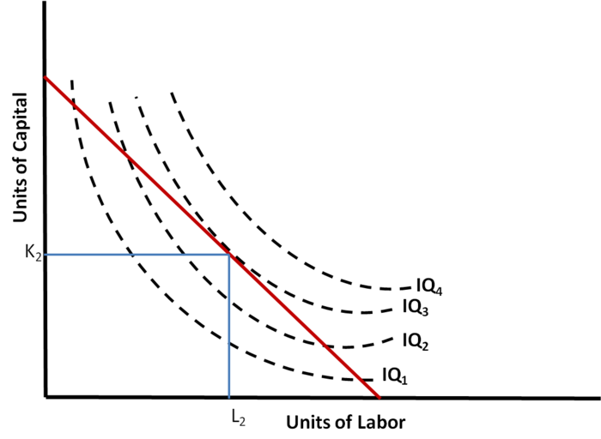
Application in Production

Slide 83


